Slide 1
Voucher App with Git and Jenkins
3SC2 Group 7
By :
Syafiq Basmallah
Zabrina Fitria

Slide 2
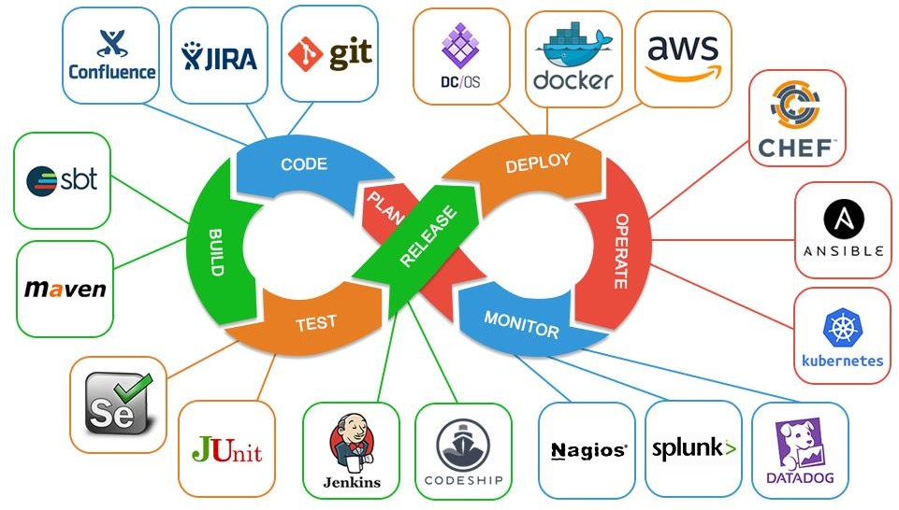
Definition of DevOps
DevOps is a software development and application delivery that combines application developer (Dev) and application operations (Ops).

Slide 3
DevOps Tool

Slide 4
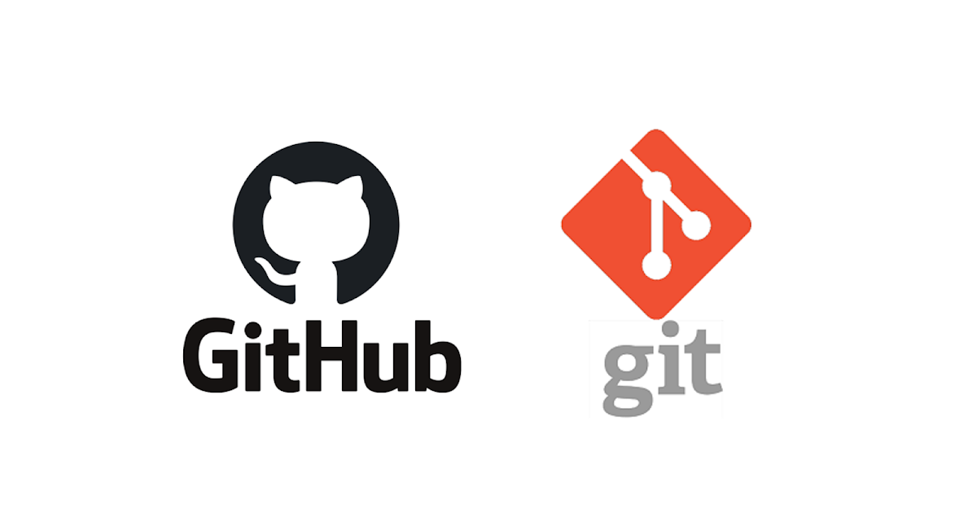
Git and Github
Git is a version control software or code management Software project created by Linus Torvalds
GitHub is a shared web hosting service for software development projects that use the Git version control system and internet hosting service

Slide 5

Jenkins
a free and open source automation server. It helps automate the software development to building, testing, and deploying, facilitating continuous integration and continuous delivery

Slide 6
What is Voucher App
Voucher App is an application where some one gives gae vouchers to be exchanged for purchasing original games or for playing games.

Slide 7
Implementing DevOps in GitHub and Jenkins

Slide 8
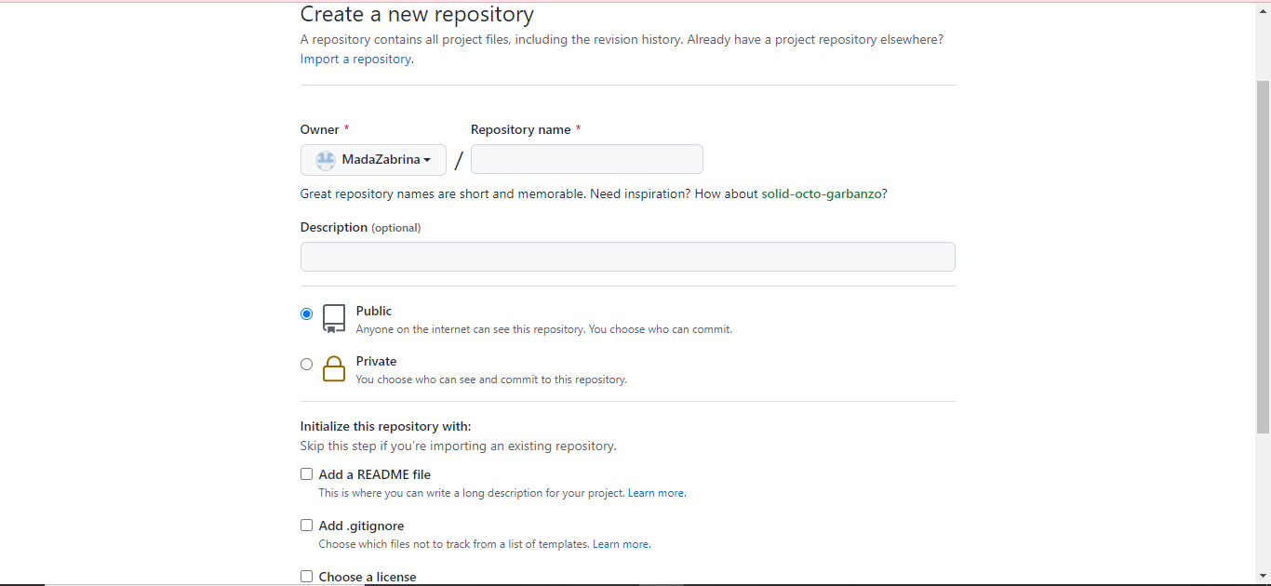
Creating New Repository

Slide 9
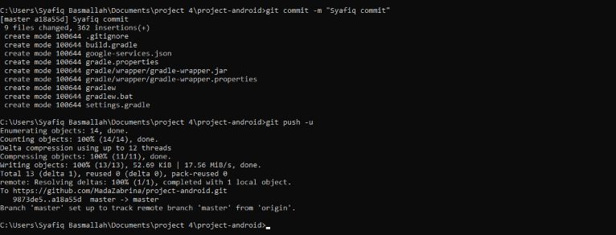
Push and Commit

Slide 10
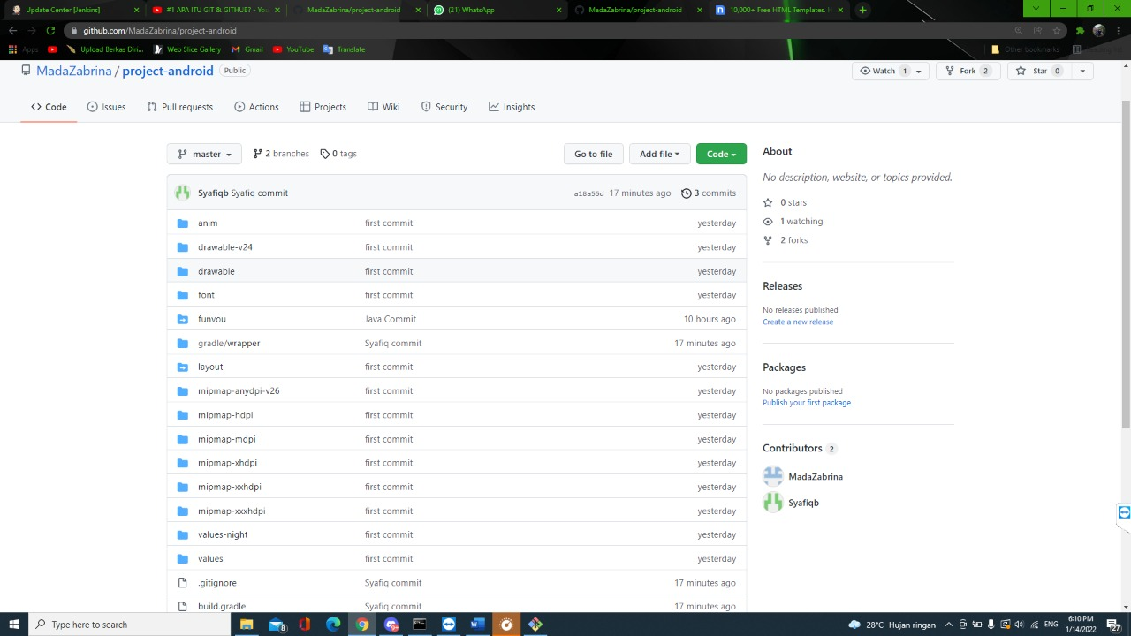
Repository Biodata

Slide 11
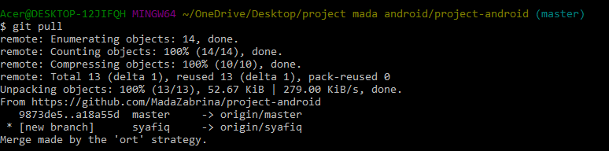
Pulling from Repository

Slide 12
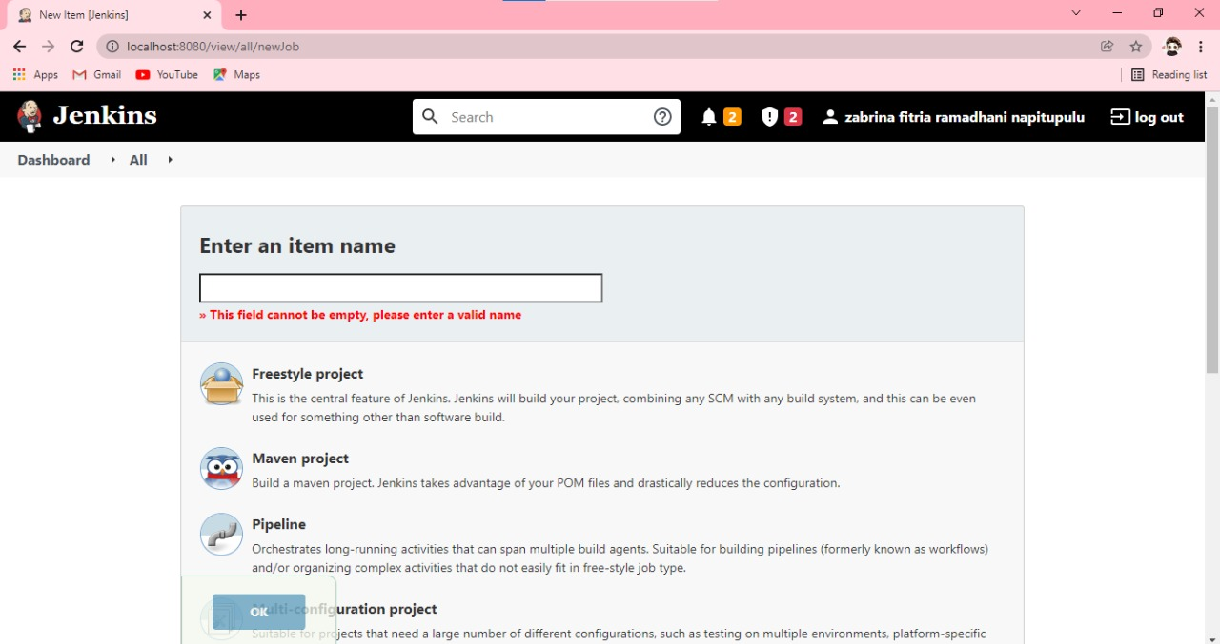
Creating New Item In Jenkins

Slide 13
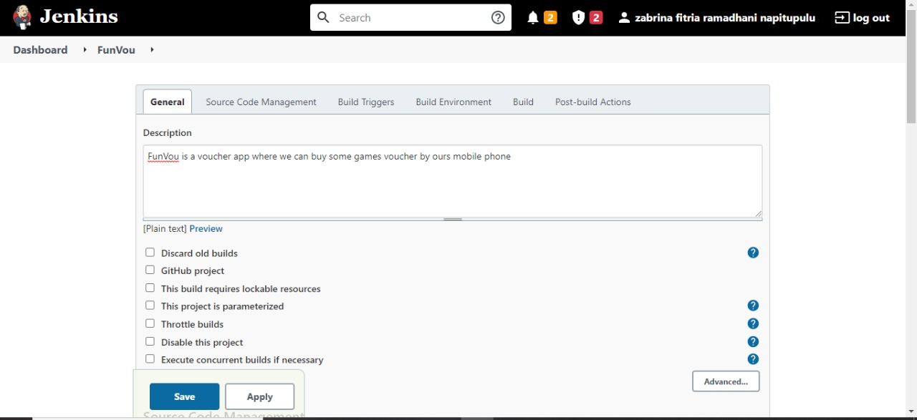
Configuring New Item

Slide 14
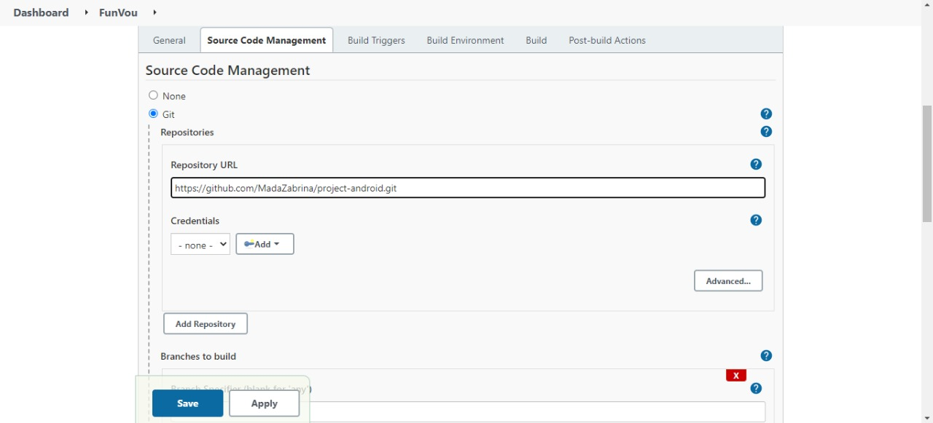
Configuring New Item

Slide 15
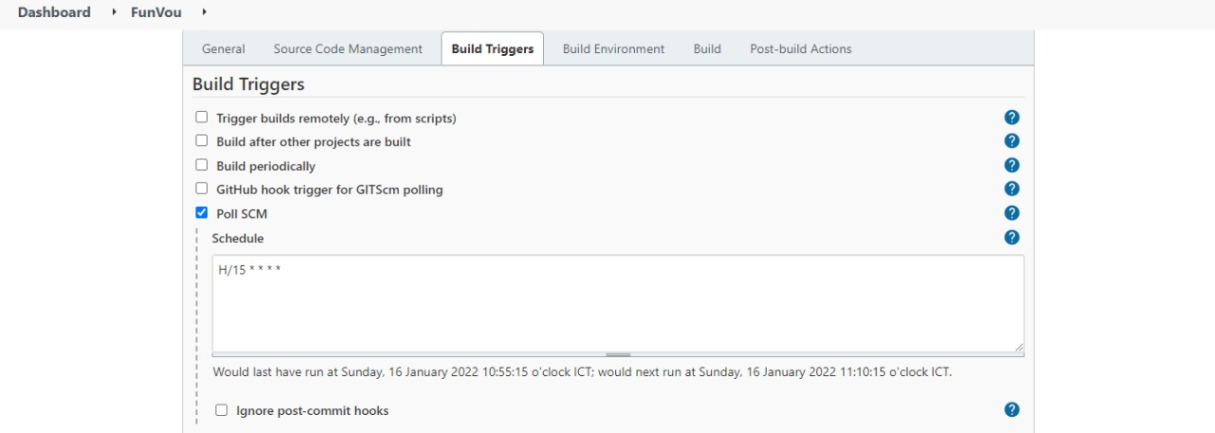
Configuring New Item

Slide 16
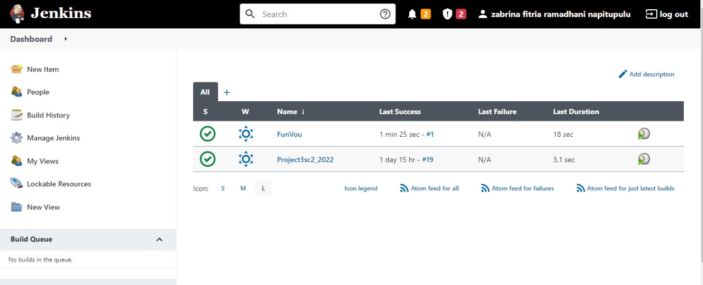
Jenkins Dashboard

Slide 17
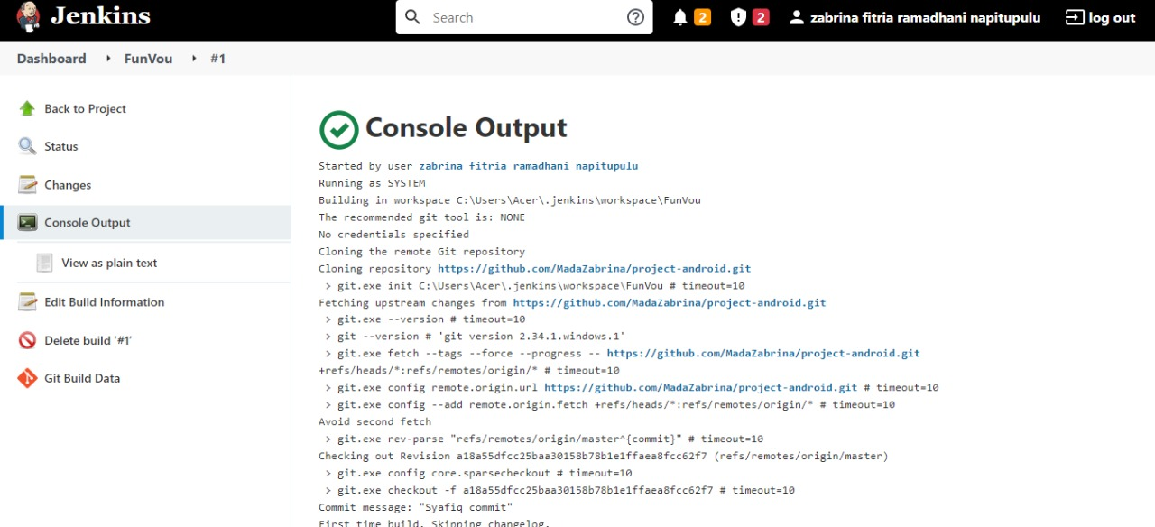
Jenkins Console Output

Slide 18
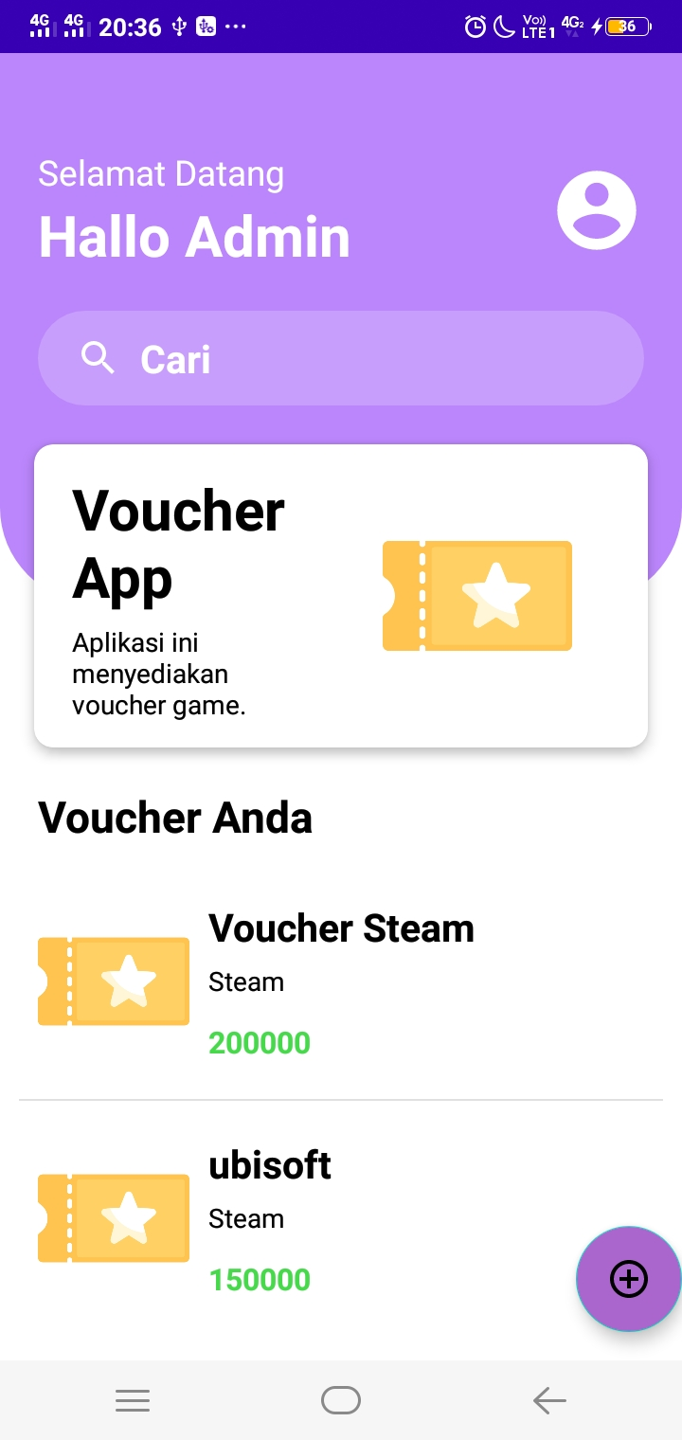
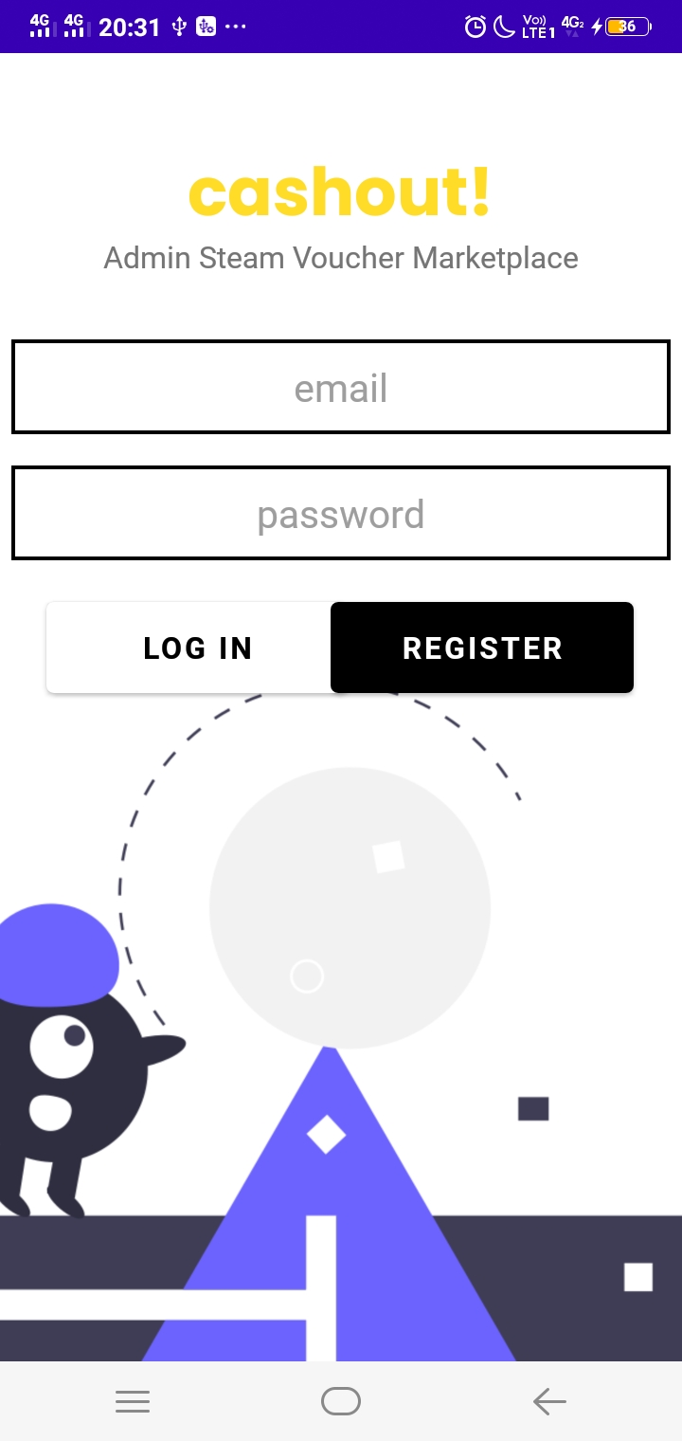
The Application

Slide 19
THANK YOU !

